Slide 1
CS2009 – Design and analysis of Algorithm
Dr. Usman Ghous
Week 3

Slide 2
Task
Determine if the below statements are either True or False
2n²= Ω (n³)
If f(n) = O(g(n)) and g(n) = O(f(n)) then f(n) = g(n)
If f(n) = O(g(n)) and g(n) = O(h(n)), then h(n) = Ω(f(n))
n/100= Ω(n)
Let f(n) = and g(n) = n². f(n) = Θ(g(n))

Slide 3
Solution
1-False
2-False f(n) = n; g(n) = n+1
3-True a<b; b<c ; a<C Transitive relation
4-True c>(1/100)
5-True

Slide 4
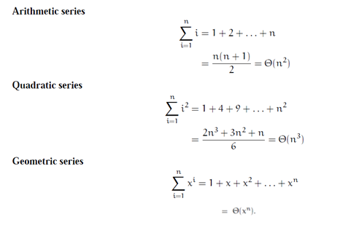


Important Summations that should be Committed to Memory.

Slide 5
O(Logn) Time Complexity of a loop is considered as O(Logn) if the loop control variables (LCV) is divided / multiplied by a constant amount.
Here c is some positive integer
for (int i = 1; i <=n; i *= c)
{ // some O(1) expressions }
for (int i = n; i > 0; i /= c)
{ // some O(1) expressions }

Slide 6
Example (Dependent nested loop)
For (i=1;i<=n;i++)
{For(j=i; j<=n;j++)
{
//sequence of statements
}
}
Arithmetic series
n+ (n-1) +(n-2)+……1= n(n+1)/2 =O(n²)

Slide 7
Task
Design nested loop in which execution of inner instructions sum to quadratic series.
For (i=1;i<=n;i++)
for (j=1;j<=i^{2;} j++)
{ //sequence of statements
}
1+4+9+…..n^2
= 2n³+3n²+n / 6
= O(n³)

Slide 8
Example (Nested loop)
for (int i = 1; i <=n; i *= 2)
{
for (int j = 1; j <= n; j *= 4)
{ // some O(1) expressions }
}
log base 2 n * log base 4 n
=O(log n)²

Slide 9
Example
int fun()
{
int count = 0;
for (int i = n; i > 0; i /= 2)
for (int j = 0; j < i; j++)
count += 1;
return count;
}

Slide 10
Explanation: For a input integer n, the innermost statement is executed following times.
n + n/2 + n/4 + … 1
= O log(n)

Slide 11
Task:
int fun(int n)
{
int count = 0;
for (int i = 0; i < n; i++)
for (int j = i; j > 0; j--)
count = count + 1;
return count;
}

Slide 12
“count = count + 1”
0 + 1 + 2 + 3 + 4 + …. + (n-1) times.
=
=(n-1)(n-1+1)/2
=(n-1)(n)/2
=O(n²)

Slide 13
Previous Lecture Example
for (i=0; i<n; i++)
{for (j=i; j<n;j++)
{
Sequence of statements….
}
}

Slide 14
n + (n-1 ) + (n-2) +…… 2+1
=
=n(n+1)/2
=O(n²)

Slide 15
Recurrence Relations

Slide 16
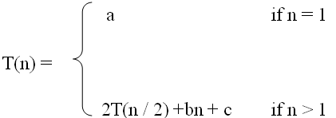

What is a recurrence relation?
A recurrence relation, T(n), is a recursive function of integer variable n.
Like all recursive functions, it has both recursive case and base case.
Example:
The portion of the definition that does not contain T is called the base case of the recurrence relation
The part that contains T is called the recurrent or recursive case.

Slide 17

Forming Recurrence Relations
For a given recursive method, the base case and the recursive case of its recurrence relation correspond directly to the base case and the recursive case of the method.
Example 1: Write the recurrence relation for the following method.
The base case is reached when n == 0. The method performs one comparison. Thus, the number of operations when n == 0, T(0), is some constant a.
When n > 0, the method performs two basic operations and then calls itself, using ONE recursive call, with a parameter n – 1.
Therefore, the recurrence relation is:
public void f (int n) {
if (n > 0) {
System.out.println(n);
f(n-1);
}
}

Slide 18

Forming Recurrence Relations
Example 2: Write the recurrence relation for the following method.
The base case is reached when n == 1. The method performs one comparison and one return statement. Therefore, T(1), is constant c.
When n > 1, the method performs TWO recursive calls, each with the parameter n / 2, and some constant # of basic operations.
Hence, the recurrence relation is:
public int g(int n) {
if (n == 1)
return 2;
else
return 3 * g(n / 2) + g( n / 2) + 5;
}

Slide 19
Solving Recurrence Relations
Methods to solve recurrence relations that represent the running time of recursive methods:
Iteration method (unrolling and summing)
Recursion tree method
Master method

Slide 20
1
Iteration Method

Slide 21
Iteration Method
Back Substitution method
unrolling and summing
Iteration consist of repeatedly substituting the recurrence into itself to obtain an summation expression

Slide 22
Analysis Of Recursive Factorial method
Example2: Form and solve the recurrence relation for the running time of factorial method and hence determine its big-O complexity:
T(0) = c
T(n) = b + T(n - 1)
= b + b + T(n - 2)
= b +b +b + T(n - 3)
…
= kb + T(n - k)
When n-k = 0, we have: n=k
T(n) = nb + T(n - n)
= bn + T(0)
= bn + c.
Therefore method factorial is O(n).
long factorial (int n) {
if (n == 0)
return 1;
else
return n * factorial (n – 1);
}

Slide 23
Analysis Of Recursive Binary Search
public int binarySearch (int target, int[] array,
int low, int high) {
if (low > high)
return -1;
else {
int middle = (low + high)/2;
if (array[middle] == target)
return middle;
else if(array[middle] < target)
return binarySearch(target, array, middle + 1, high);
else
return binarySearch(target, array, low, middle - 1);
}
}
The recurrence relation for the running time of the method is:
T(1) = a if n = 1 (one element array)
T(n) = T(n / 2) + b if n > 1

Slide 24
Analysis Of Recursive Binary Search
Expanding:
T(n) = T(n / 2) + b
= [T(n / 4) + b] + b = T (n / 2²) + 2b
= [T(n / 8) + b] + 2b = T(n / 2³) + 3b
= ……..
= T( n / 2^{k}) + kb
When n / 2^{k} = 1 ➔ n = 2^{k} ➔ k = log n, we have:
T(n) = T(1) + b log n
= a + b log n
Therefore, Recursive Binary Search is O(log n)

Slide 25
Task
T(n) = T(n-1) + bn
T(0) = c

Slide 26
T(n) = T(n-1) + bn
= (T(n-2) + b(n-1)) + bn
= T(n-3) + b(n-2)) +b(n-1) + b(n)
= T(n-4) + b(n-3)+ b(n-2)) +b(n-1) + b(n)
= T(n-4) + b[(n-3)+ (n-2) +(n-1) + n]
Generalizing this to k would give us
= T(n-k) + b[(n-k+1)+... +(n-3)+ (n-2) +(n-1) + n]
= T(n-k) +b. k(k-1)/2
n-k=0 => n=k
= T(0)+b[(n-1)(n)/2]
=c+ b[(n-1)(n)/2] = c+bn^2/2+bn/2
=O(n^2)

Slide 27
Home Task
T(n) = T(n-1) + n
T(1) = c

Slide 28
2
Recursion Tree Method

Slide 29
Recursion tree method
Solving recurrences
expanding the recurrence into a tree
summing the cost at each level
Difference between depth and height of node

Slide 30
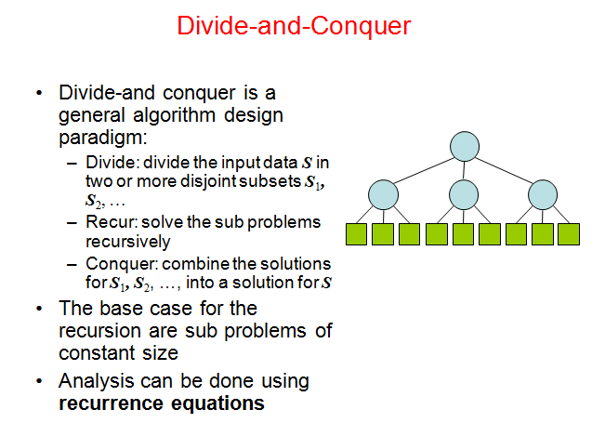

Slide 31
Recursion tree
Solve T(n) = 2T(n/2) + c n, where c > 0 is constant.
T(n)
Here Tree nodes represent costs incurred at various levels of the recursion.

Slide 32
Recursion tree
Solve T(n) = 2T(n/2) + cn, where c > 0 is constant.
cn
T(n/2)
T(n/2)

Slide 33
Recursion tree
Solve T(n) = 2T(n/2) + cn, where c > 0 is constant.
cn
cn/2
cn/2
T(n/4)
T(n/4)
T(n/4)
T(n/4)

Slide 34
Recursion tree
Solve T(n) = 2T(n/2) + cn, where c > 0 is constant.
cn
cn/2
cn/2
cn/4
cn/4
cn/4
cn/4
…
Ο(1)

Slide 35
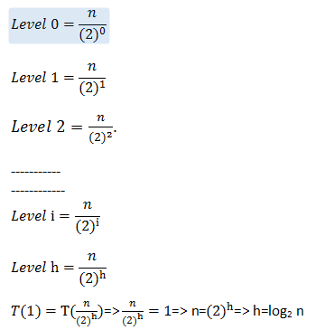
Determining depth/height of tree

Slide 36
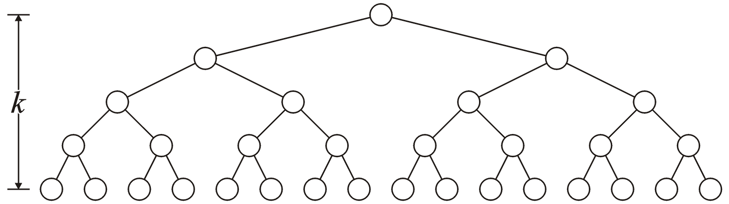
Binary Tree: Properties
A perfect binary tree with height h has 2^{h} leaf nodes
A perfect binary tree of height h has 2^{h + 1} – 1 nodes
Number of leaf nodes: L = 2^{h}
Number of internal nodes: 2^{h} – 1
Total number of nodes: 2L-1 = 2^{h + 1} – 1
h

Slide 37
Binary Tree: Properties
A perfect binary tree with height h has 2^{h} leaf nodes
A perfect binary tree with n nodes has height log₂(n + 1) – 1
Number of leaf nodes: L = 2^{h}
Number of internal nodes: 2^{h} – 1
Total number of nodes: 2L-1 = 2^{h + 1} – 1

Slide 38
Recursion tree
Solve T(n) = 2T(n/2) + cn, where c > 0 is constant.
cn
cn/2
cn/2
h = log n
cn/4
cn/4
cn/4
cn/4
…
Ο(1)

Slide 39
Recursion tree
Solve T(n) = 2T(n/2) + cn, where c > 0 is constant.
cn
cn
cn/2
cn/2
h = log n
cn/4
cn/4
cn/4
cn/4
…
Ο(1)

Slide 40
Recursion tree
Solve T(n) = 2T(n/2) + cn, where c > 0 is constant.
cn
cn
cn/2
cn/2
cn
h = log n
cn/4
cn/4
cn/4
cn/4
…
Ο(1)

Slide 41
Recursion tree
Solve T(n) = 2T(n/2) + cn, where c > 0 is constant.
cn
cn
cn/2
cn/2
cn
h = log n
cn/4
cn/4
cn/4
cn/4
cn
…
…
Ο(1)

Slide 42
Recursion tree
Solve T(n) = 2T(n/2) + cn, where c > 0 is constant.
cn
cn
cn/2
cn/2
cn
h = log n
cn/4
cn/4
cn/4
cn/4
cn
…
…
Ο(1)
#leaves = n
Ο(n)

Slide 43
Recursion tree
Solve T(n) = 2T(n/2) + cn, where c > 0 is constant.
cn
cn
cn/2
cn/2
cn
h = log n
cn/4
cn/4
cn/4
cn/4
cn
…
…
Ο(1)
#leaves = n
Ο(n)
Total = Ο(n log n)

Slide 44


Slide 45
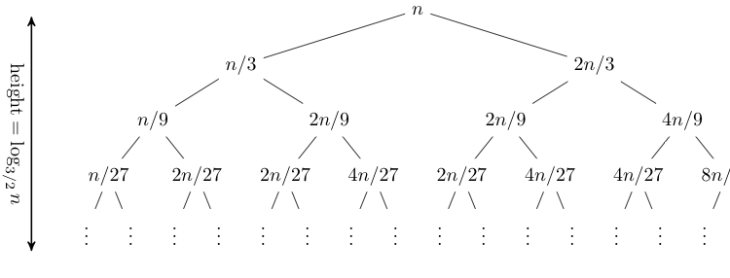
Let's consider another example,
T(n) = T(n/3) + T(2n/3) + n.
Expanding out the first few levels, the recurrence tree is:
the closed form of this recurrence is O(n log n).

Slide 46
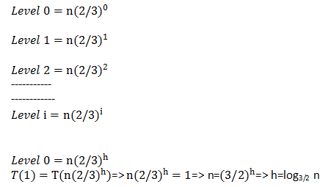
Determining Height of tree

Slide 47
Home Task
Solve
T(n) = T(n/2) + 1
T(n) = 2T(n/2) + n²
T(n) = 3T(n/4) + cn²
T(n) = 5T(n-6) + c

Slide 48
Reading Material
Recursion Tree Method to Solve Recurrences (codesdope.com)
Lecture 20: Recursion Trees and the Master Method (cornell.edu)

